Slide 1
Web Browsing Policy Compliance Monitoring Using Keylogging

Slide 2
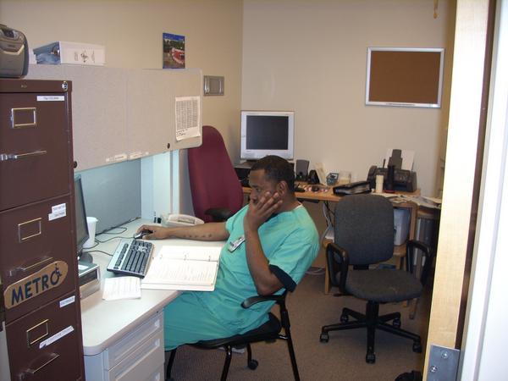
Background Story
Problem and Motivation
You have been hired as the lead IT Administrator at B.A.D. Inc they are a Microsoft sourcing company. They are having an issue with their workings not performing to par seems if they are spending most of their time surfing the web for personal agendas and not business related things,. These users can become both bandwidth hogs, and potential security risks. Your job is to prevent users from circumventing the internet policy.

Slide 3
Methods
HTTP proxy
False user agents

Slide 4
Solution
There are several methods involved in curcumventing internet restrictions. Almost all require some type of user input. The keyboard is a violator’s best friend. A simple solution is to monitor the input of the actual keyboard through keylogging.

Slide 8
Disclaimer: The keylogger we are using is not provided by Kaseya, you must find a compatible keylogging program

